Slide 1



Conference Application
For American Society of Civil Engineers
Notes:
Salma and Amanda

Slide 2



Team and Client
Team:
Salma Mala and Amanda McMahon
Client:
Dr. Jill Walsh
Professor of the Engineering Department
Notes:
Salma and Amanda

Slide 3
Project Description and Motivation
Our project is to create an application for the upcoming American Society of Civil Engineers-ASCE conference, 2019 at Saint Martin’s University. In this app students will be able to search schedules, locations, campus maps, room setting, and food options near as well as the university cafeteria. The app will also send out notifications prior to a session starting.
Notes:
Salma

Slide 4
Problem Solving
Gathering related information from different sources
Limited time
(ASCE2019: April 11th-13th)
Needed a third party to launch the app in the app store
Connecting SQL to HTML through PHP
Communicating with the clients to figure out exactly what they need/want
Creating ERD
Creating a design
Getting feedback from the clients on the design
Making it easy for the users to use the app
Planned a process
Notes:
Salma

Slide 5

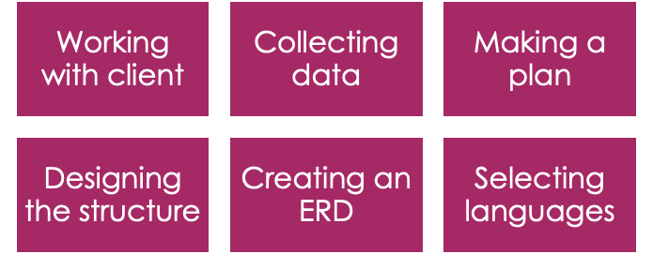
Process
Notes:
Salma

Slide 6
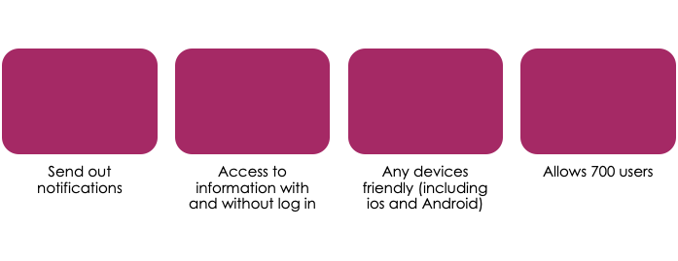




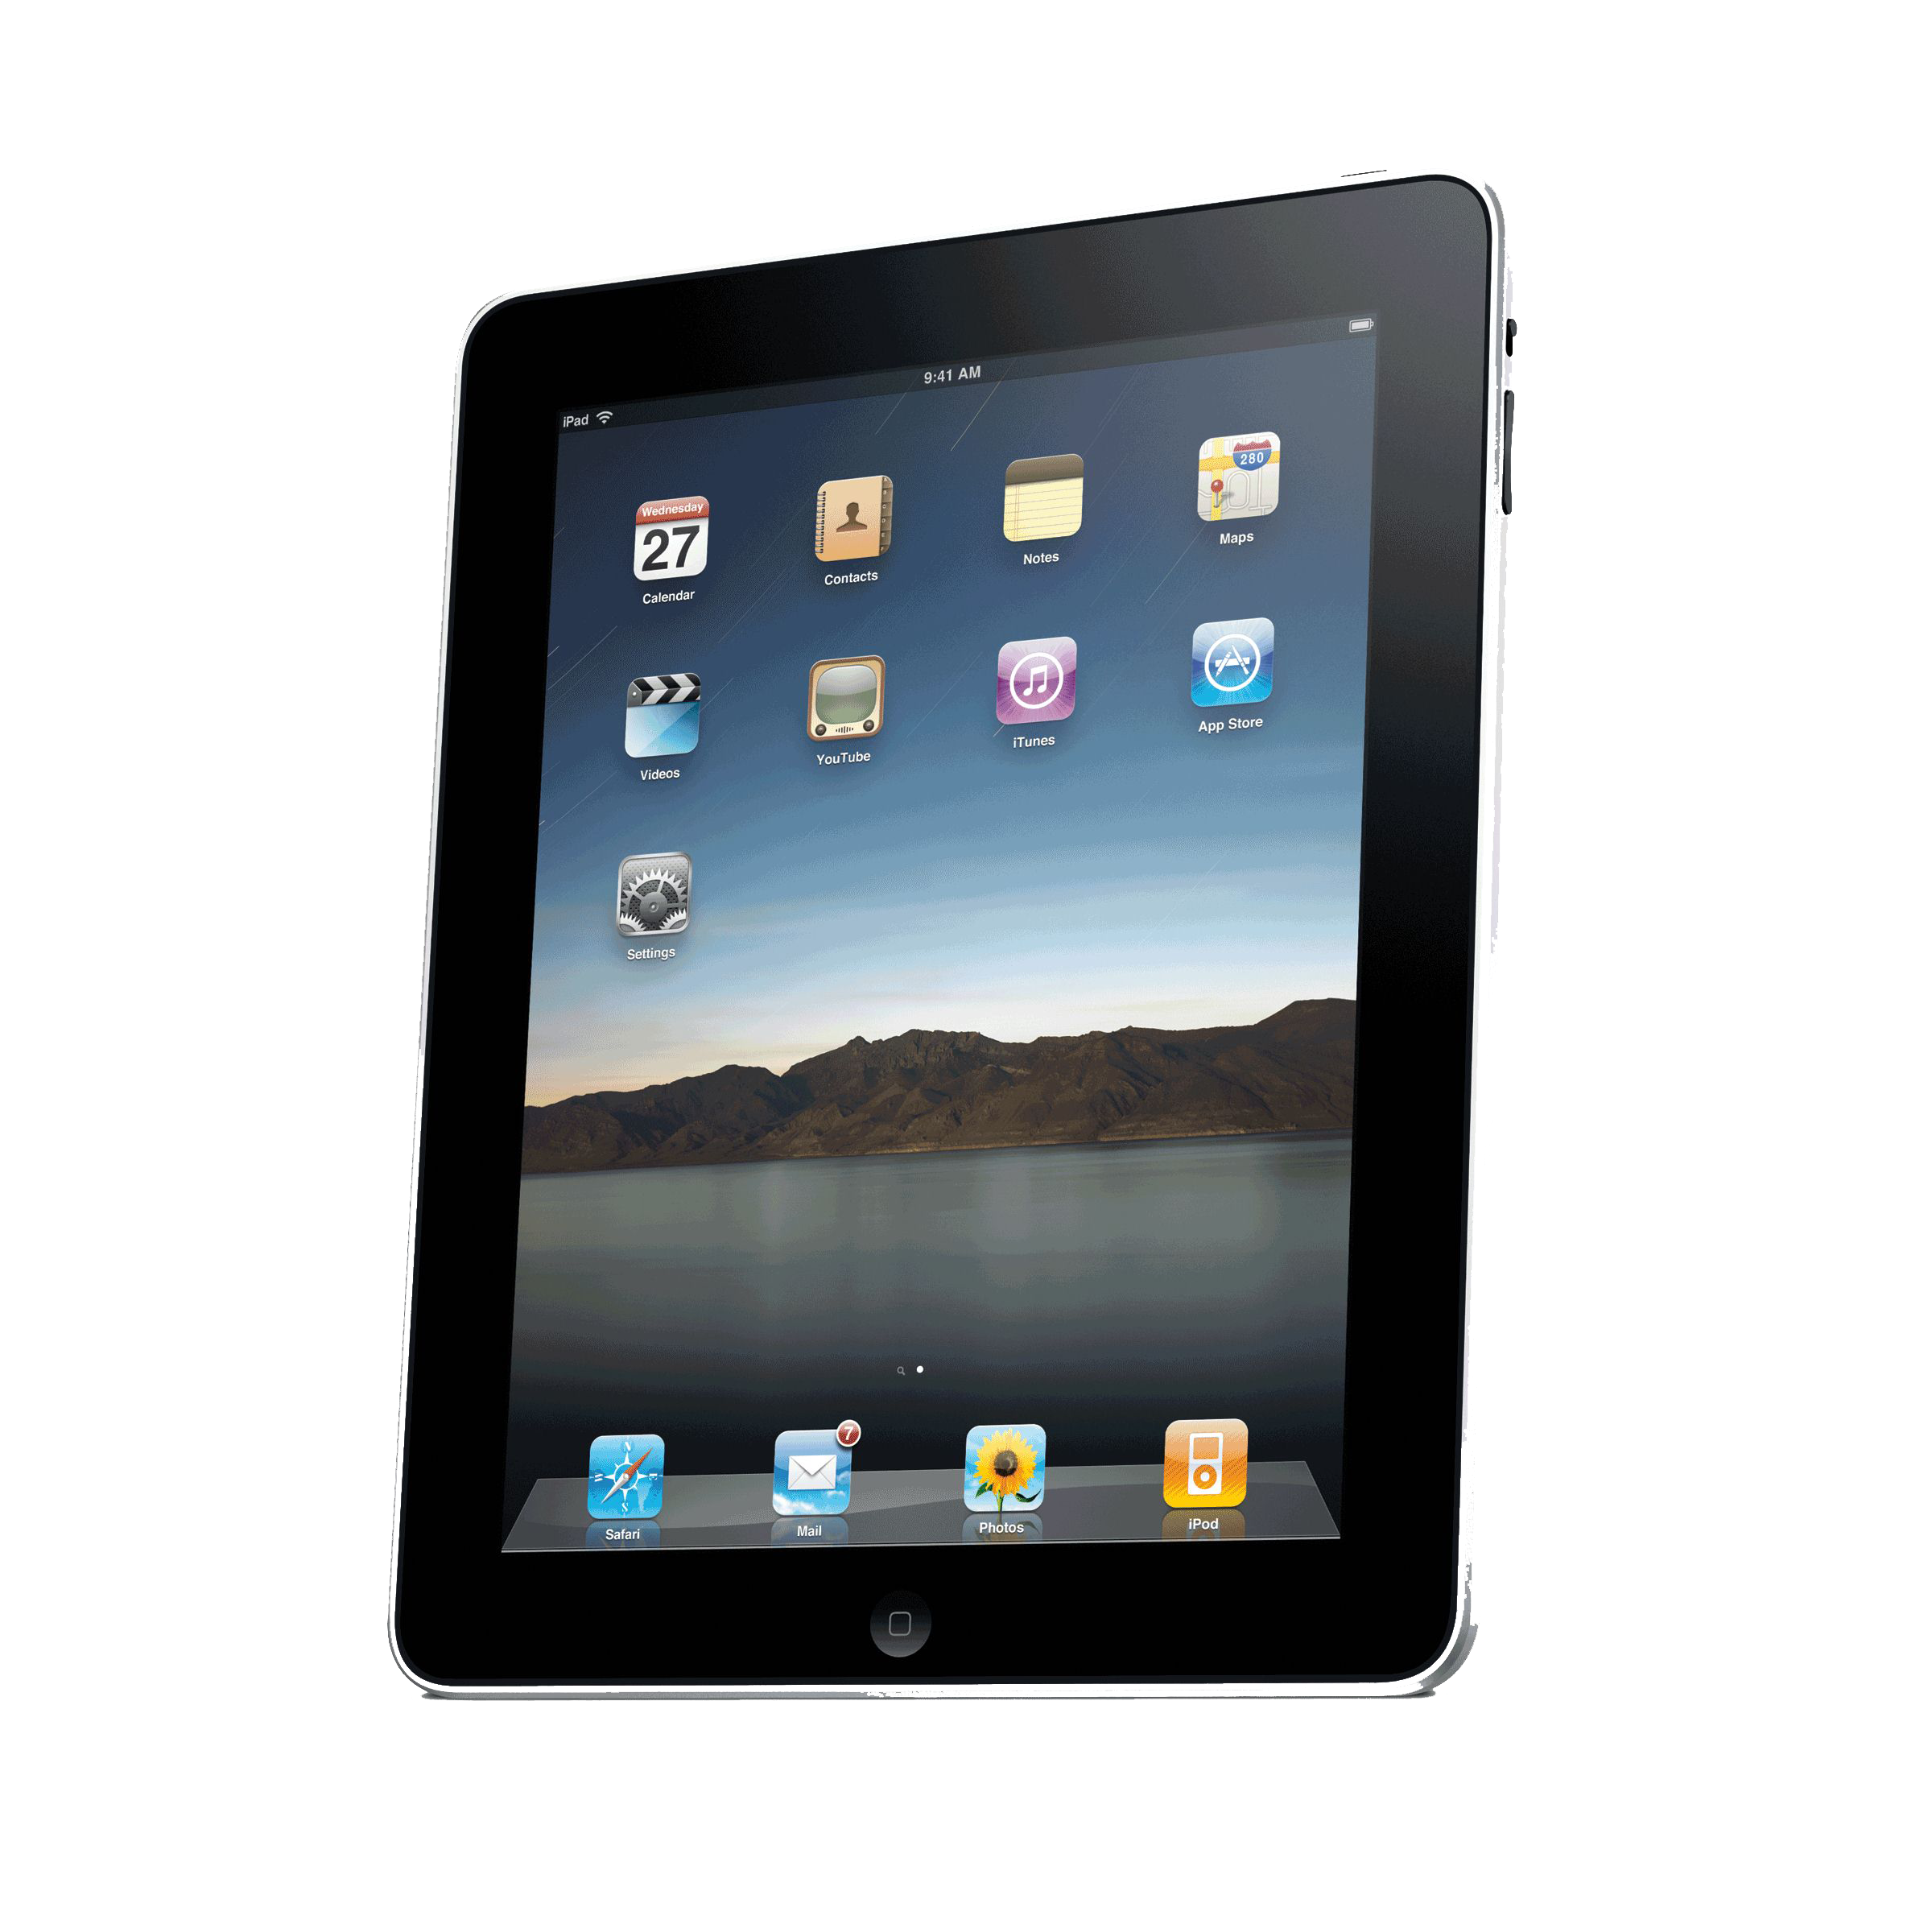
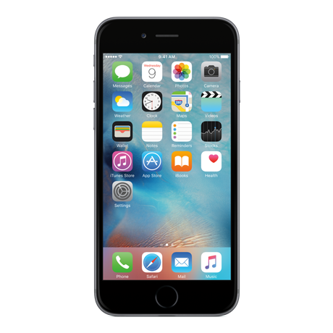
Features
Notes:
Salma

Slide 7
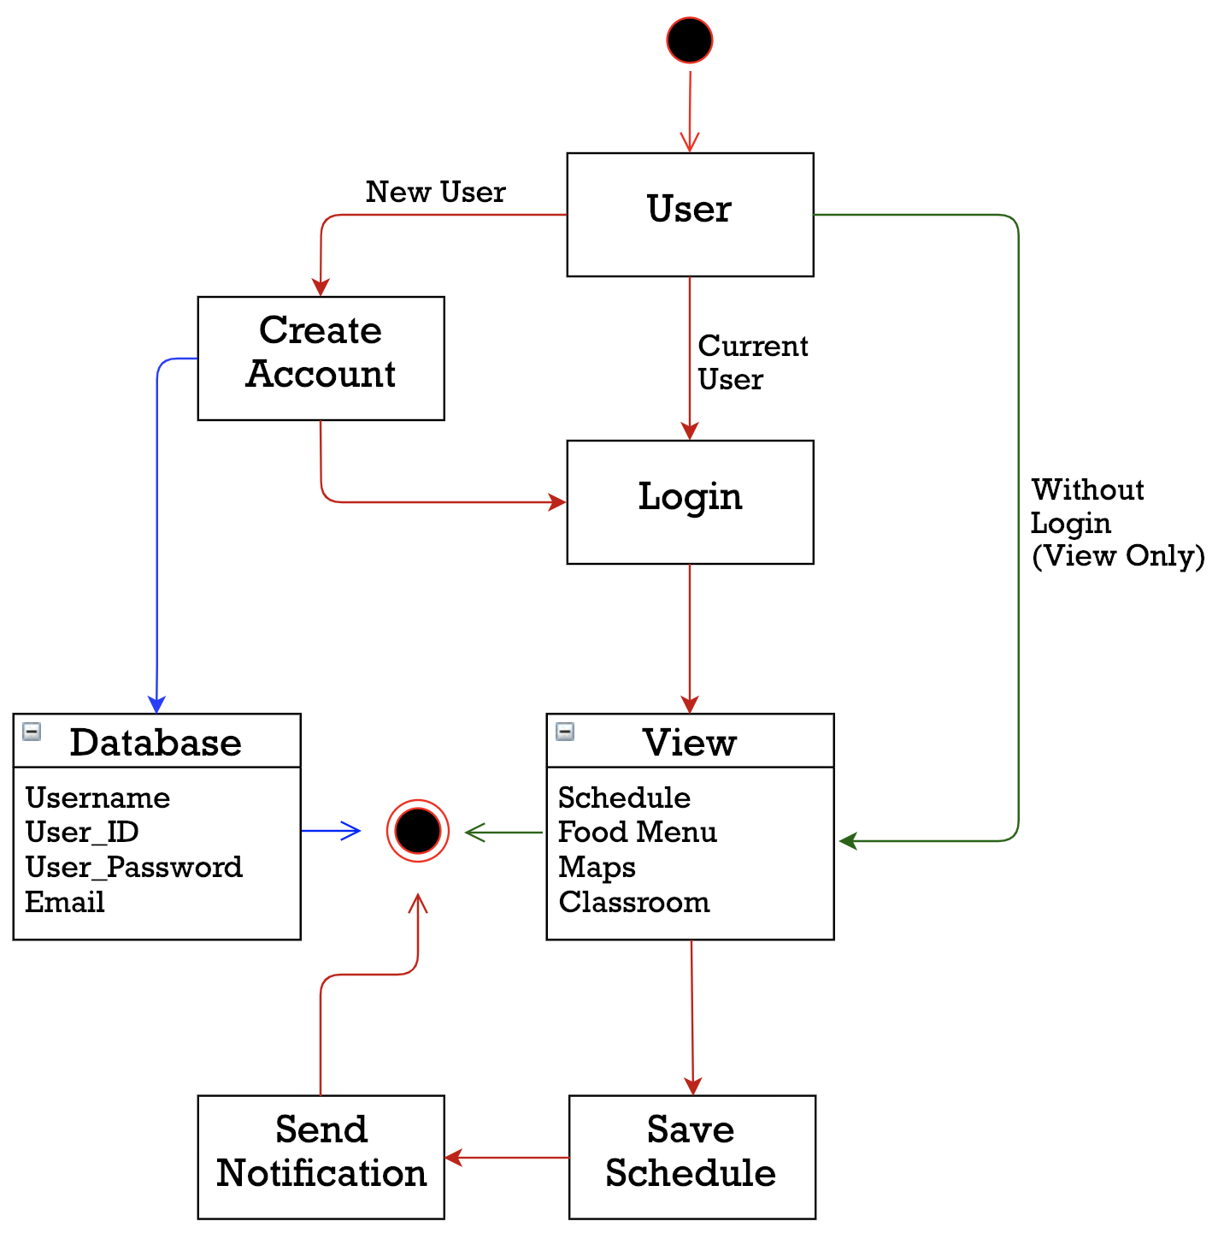
ERD - Entity Relationship Diagram
Creating a diagram of the project helps us visualize how everything is connected.
The arrows are color coded to help show the separate processes.
Notes:
Amanda

Slide 8
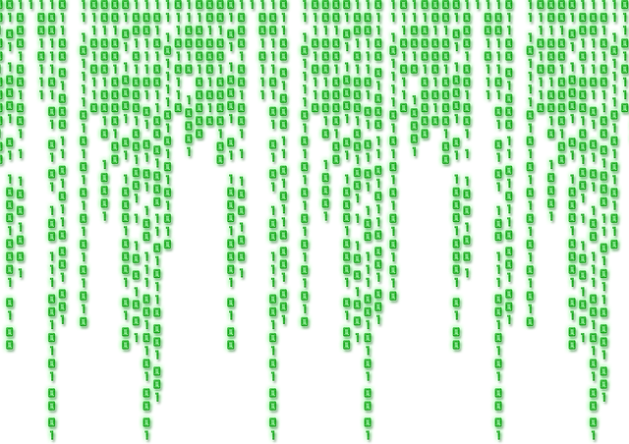
Coding and Languages
HTML
To create the webpage
CSS
Style and organize the webpage
JavaScript
For features that require more complex coding
PHP
To connect the webpage to the database
SQL
To create a database for login and other necessary information
Notes:
Amanda

Slide 9
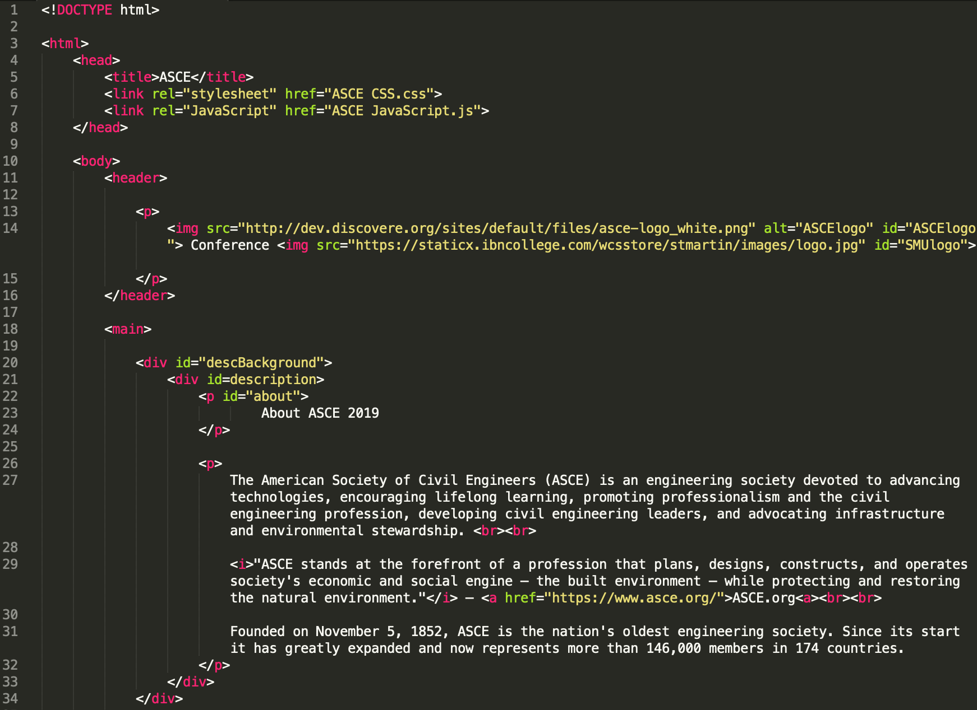
Code: HTML
Notes:
Amanda

Slide 10
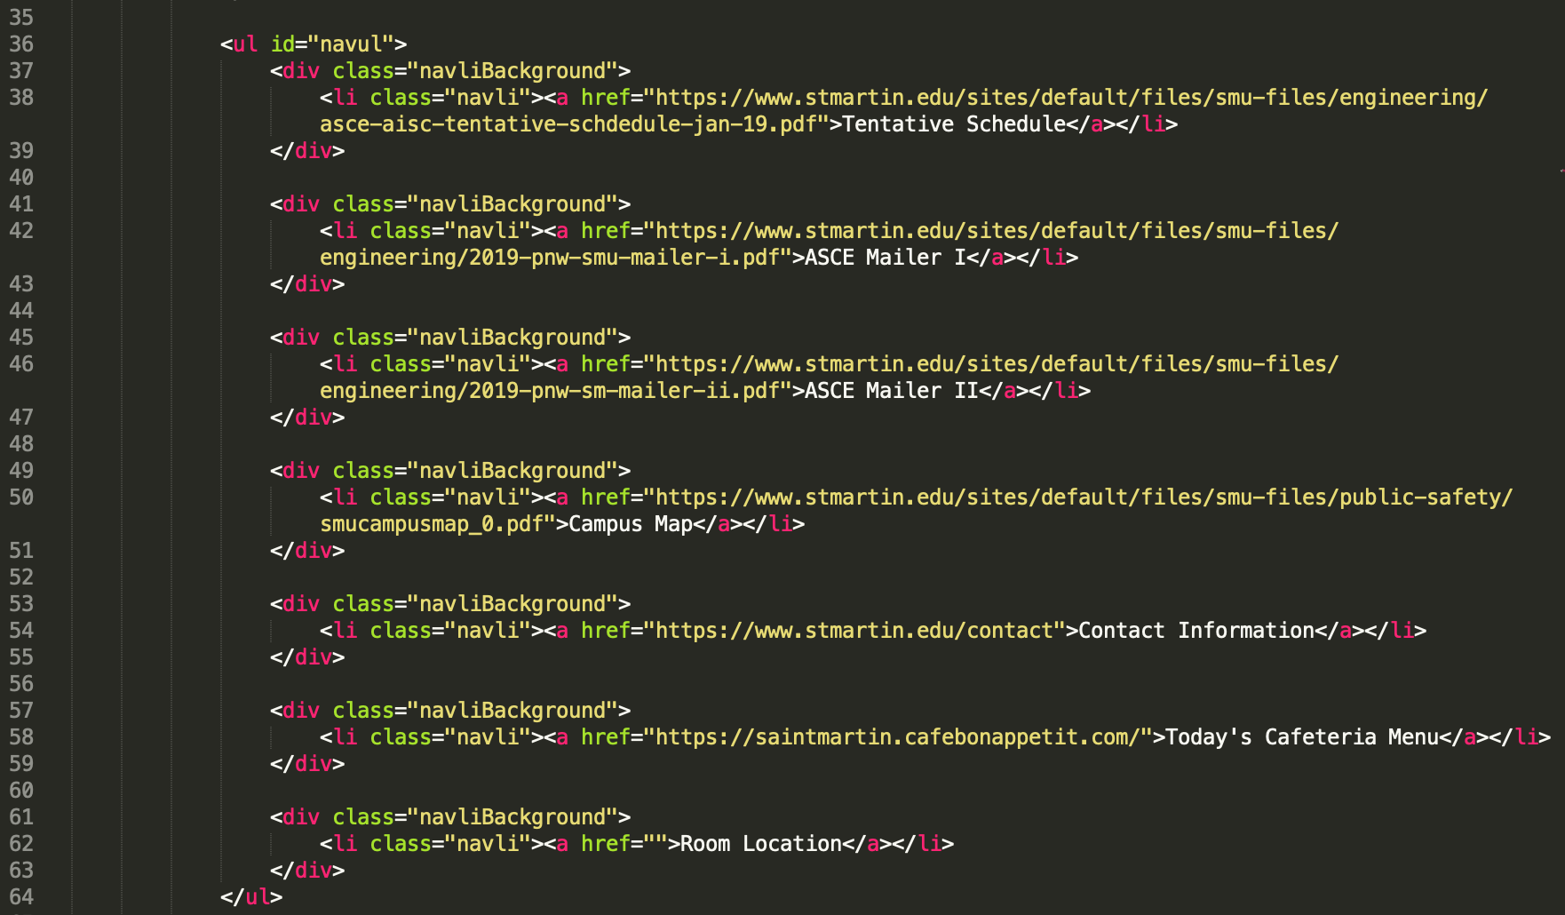
Code: HTML Cont.
Notes:
Amanda

Slide 11
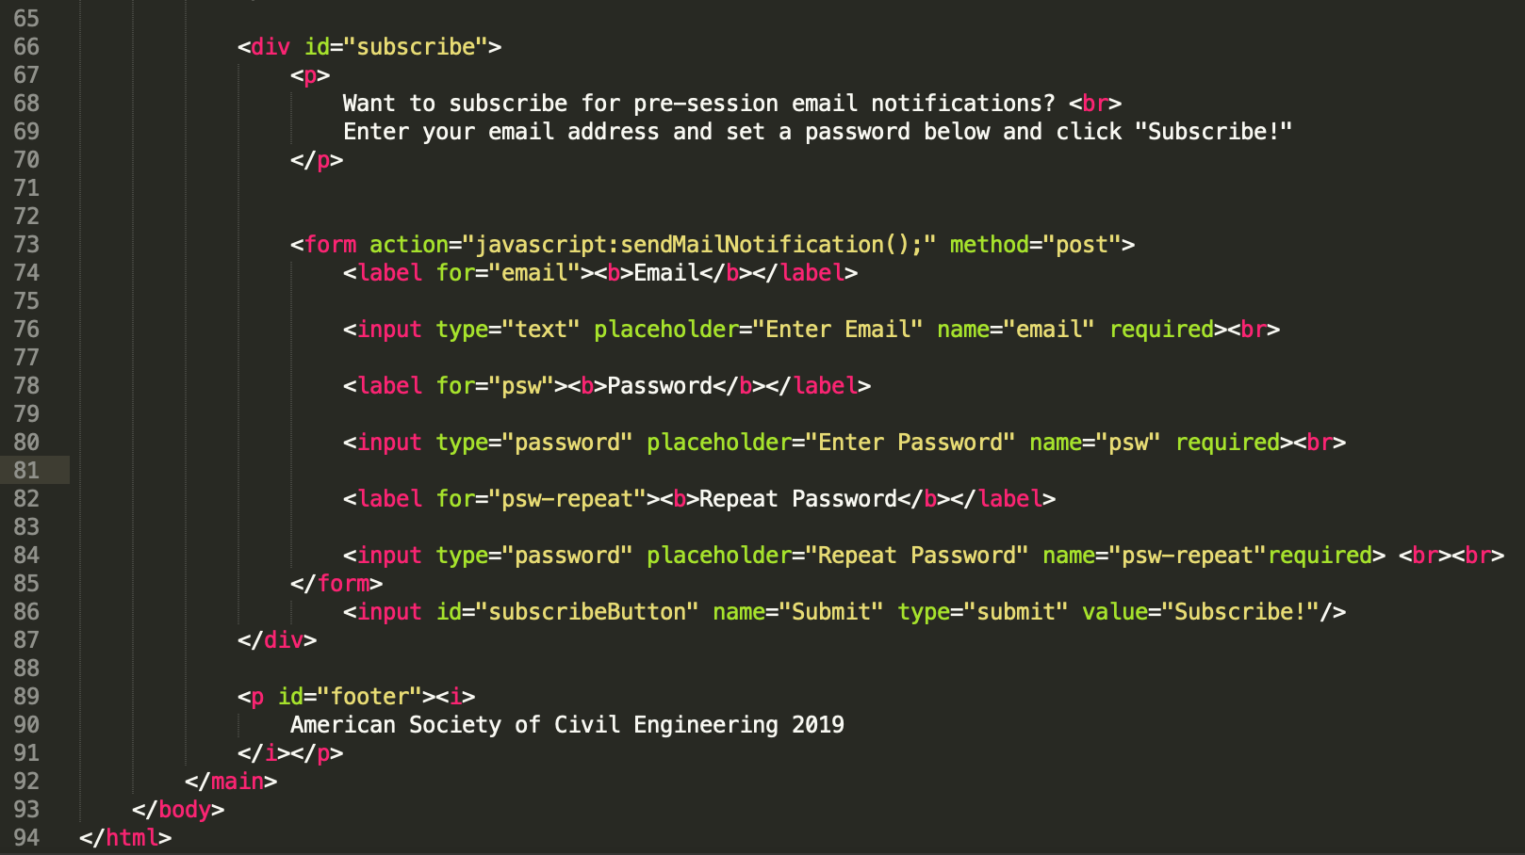
Code: HTML Cont.
Notes:
Amanda

Slide 12
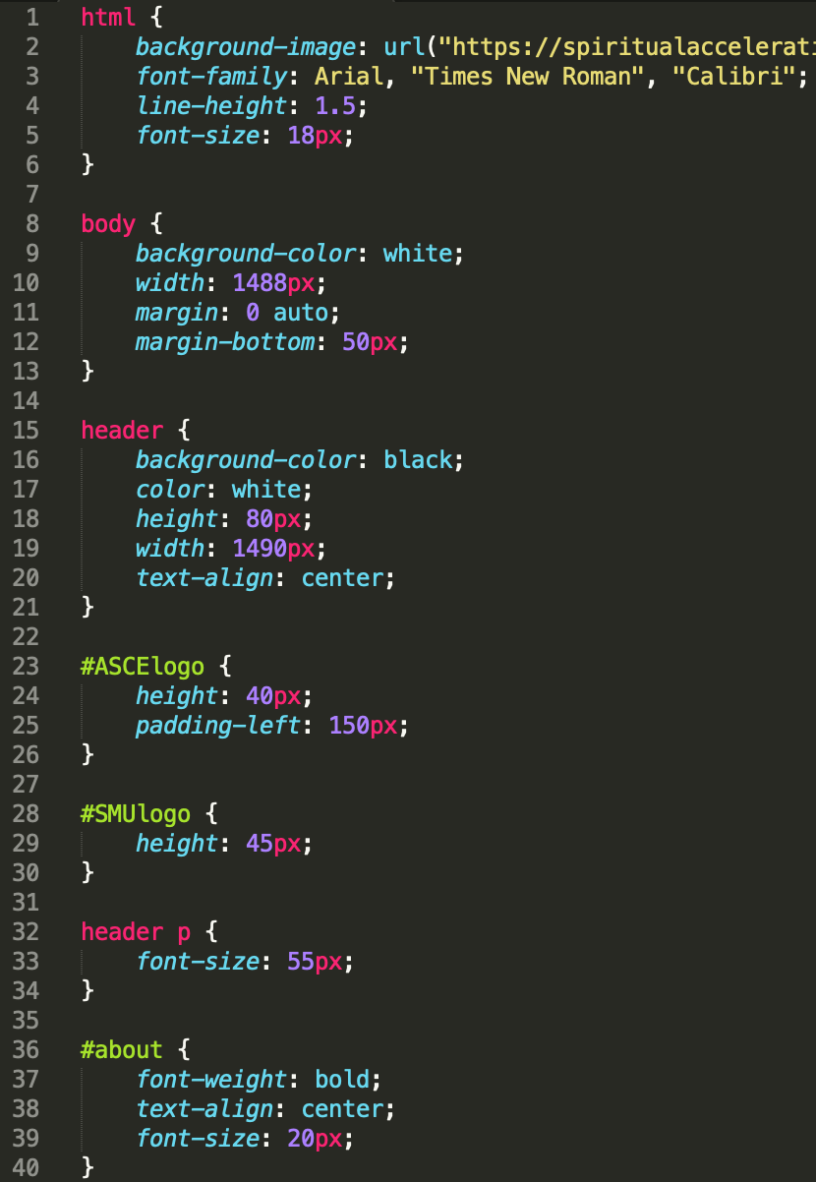
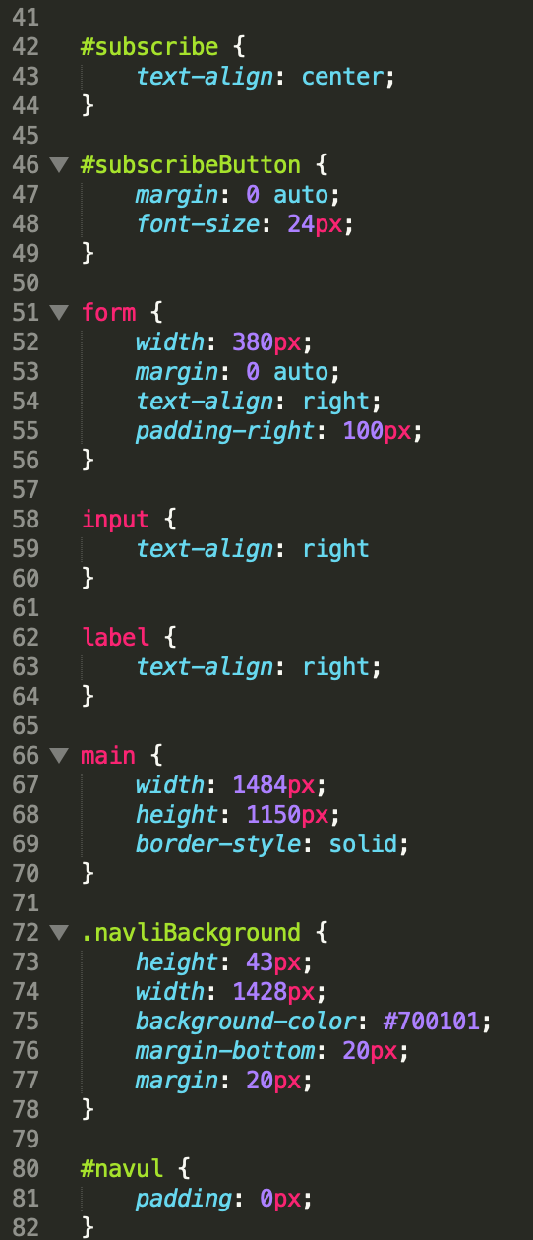
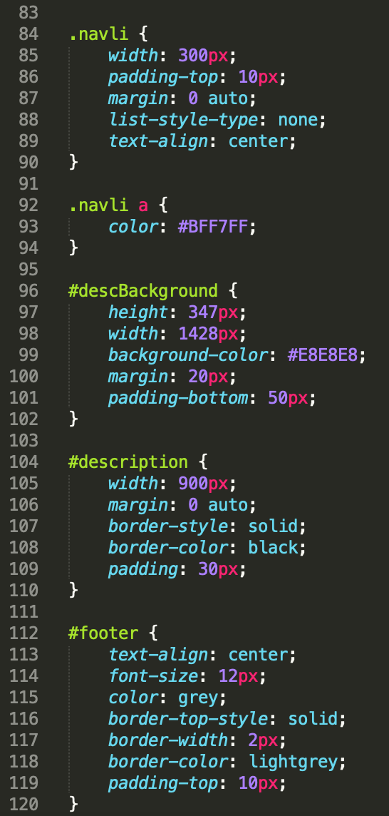
Code: CSS
Notes:
Amanda

Slide 13

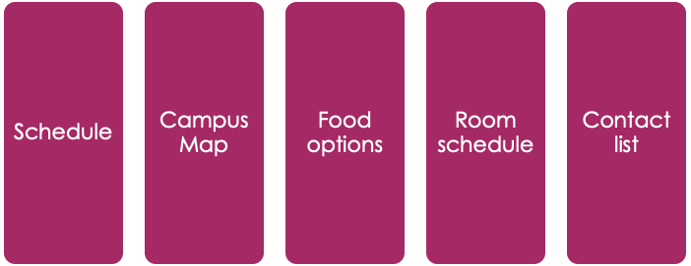

Data
Notes:
Salma

Slide 14
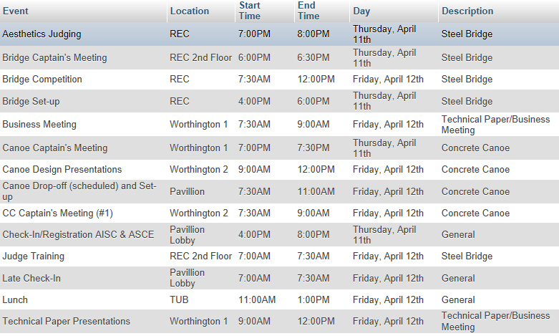
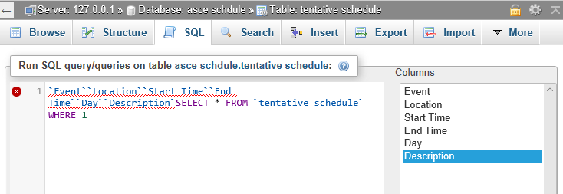
Database: MySQL
Notes:
Salma

Slide 15

Plan to Finish the Project
Code
Gather, organize, and style source code
Add
Add desired features
Mobile
Convert website to mobile application
Publish
Publish application to IOS and on Android
Notes:
Salma and Amanda

Slide 16
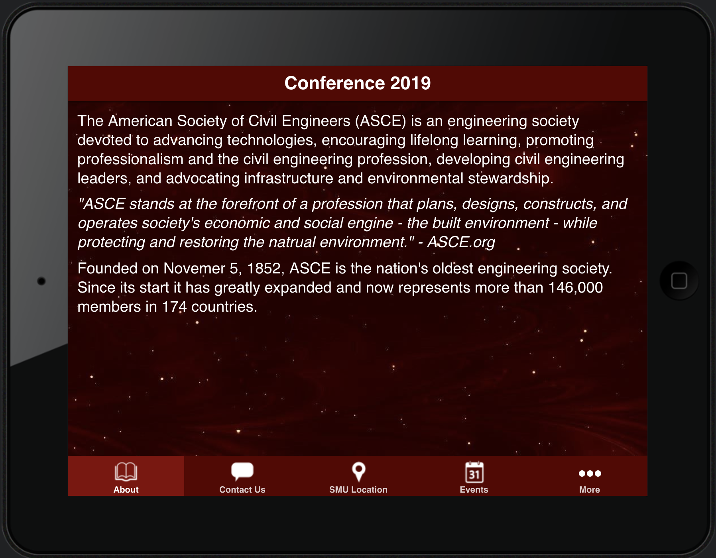
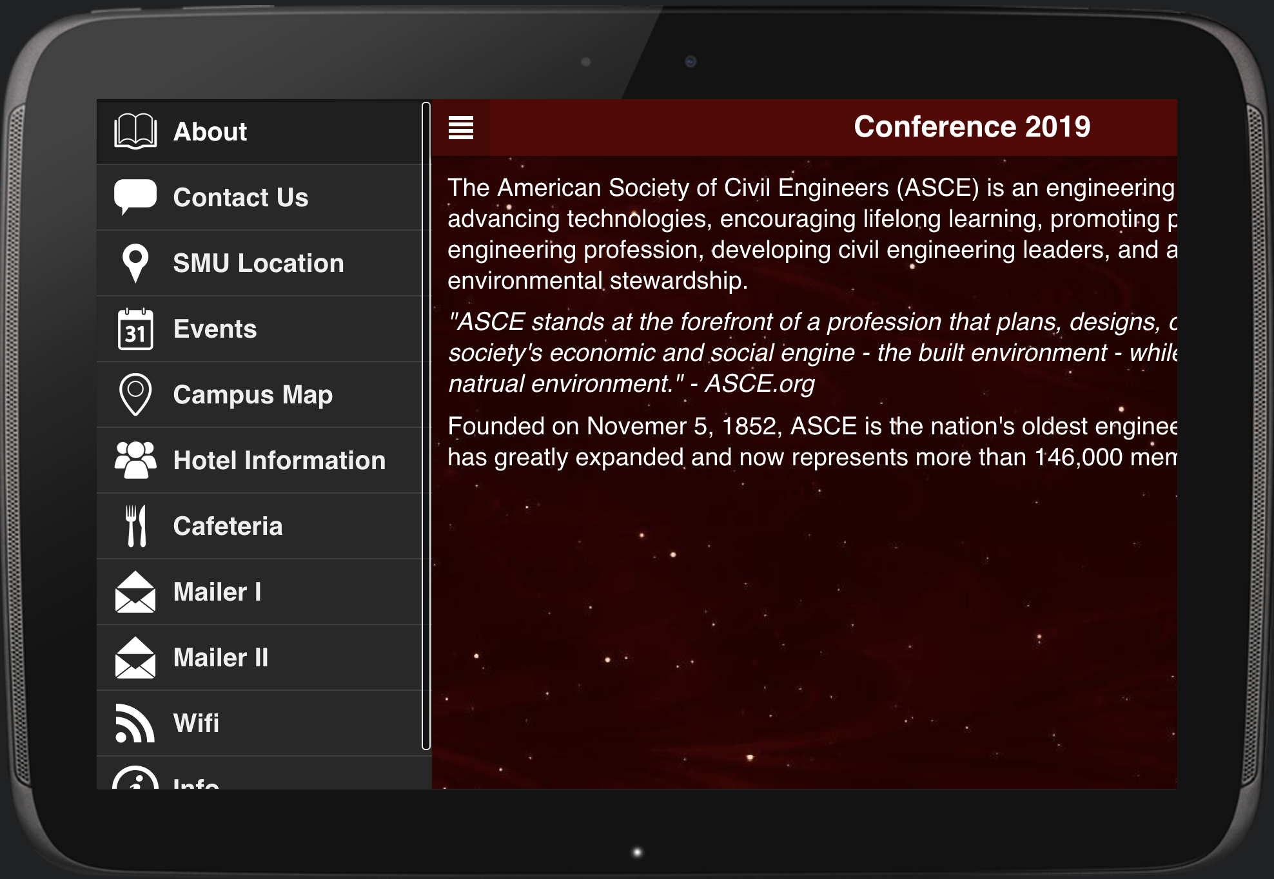
Application Visualization: Tablet
Apple
Android
Notes:
Salma

Slide 17
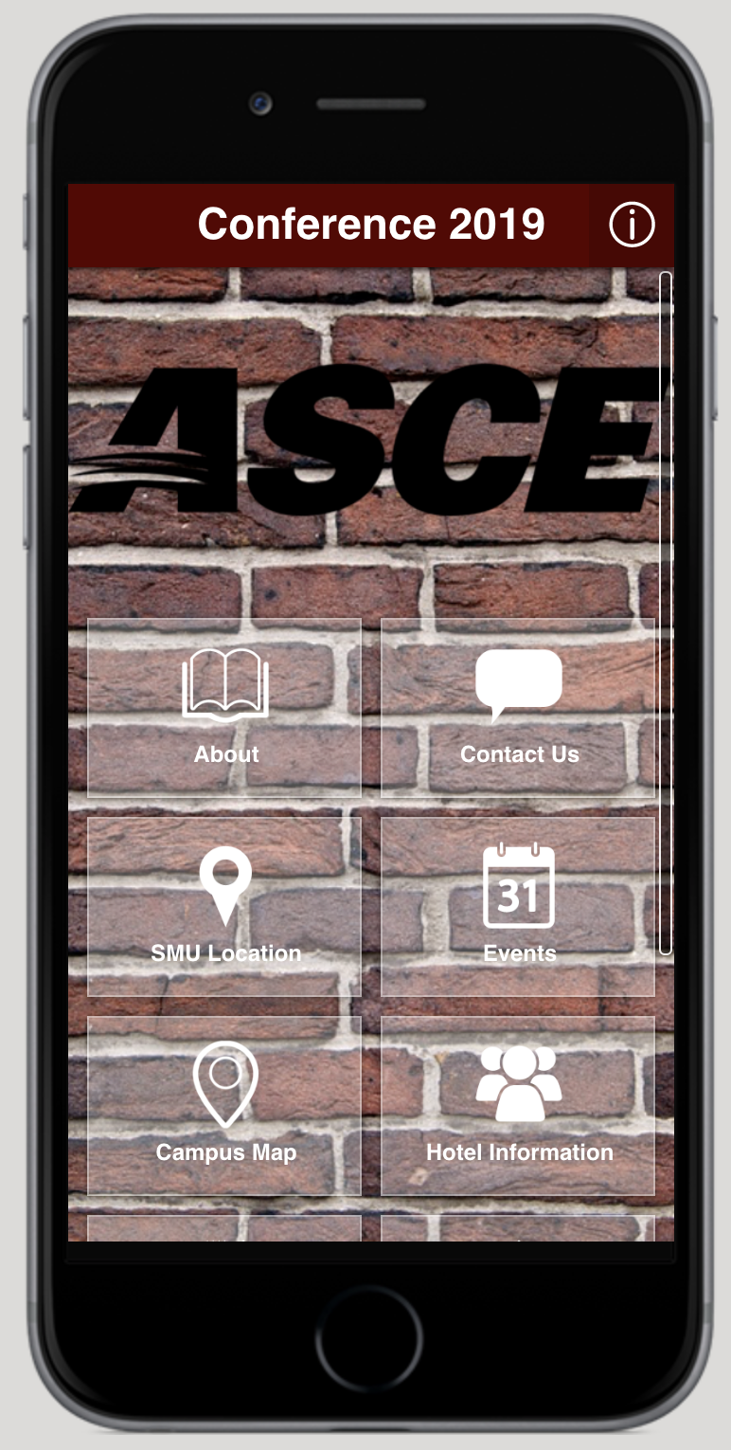
Application Visualization: Smartphone
Apple and Android
Notes:
Amanda

Slide 18
Thank you !
Any Questions?
Notes:
Salma anda Amanda

